Slide 1
Rendering Methods & Models

Slide 2
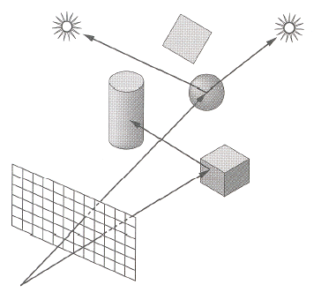
Shading
Compute the radiance for each object
Figure out which pixels to fill
Determine a color for each filled pixel

Slide 3
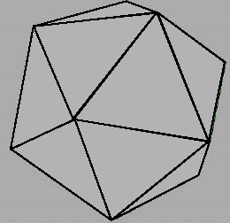
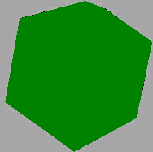
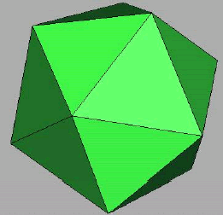
Illumination Components
Emission at light sources
Scattering at surfaces
Wireframe
Without Illumination
With Illumination

Slide 4

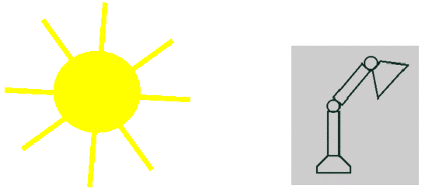
Light Source Model
Simple mathematical models
Point light
Directional light
Spot light

Slide 5
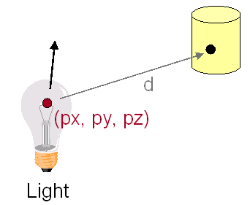
Point Light Source
Omni-directional point source, ex) bulb
Intensity (I)
Position (px, py, pz)

Slide 6
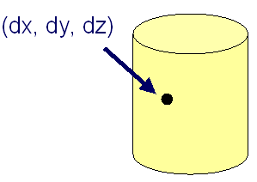
Directional Light Source
Point light source at infinity, ex) sun
Intensity (I)
Direction (dx,dy,dz)

Slide 7
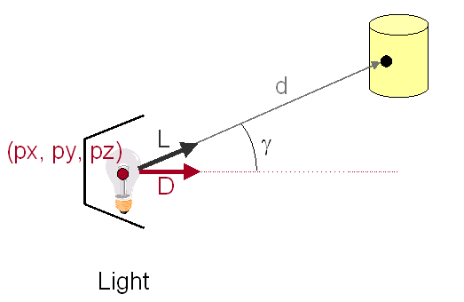
Spot Light Source
Point light source with direction, ex) Luxo
Intensity (I)
Position (px, py, pz)
Direction (dx, dy, dz)

Slide 8
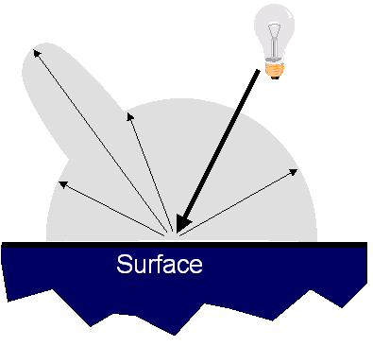
Reflectance Model
Simple analytic model
Emission
Ambient
Diffuse reflection
Specular reflection

Slide 9
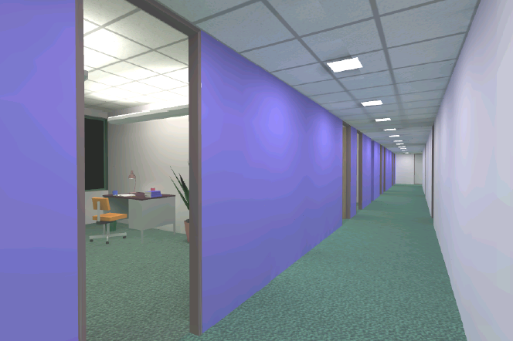
Emission
Light emitting directly from surfaces
ex) light source
Emission ≠ 0

Slide 10
Ambient Term
Compensated reflection of indirect illumination

Slide 11
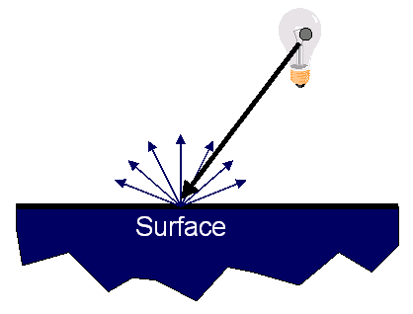
Diffuse Reflection
Surface reflects equally in all directions
With equal intensity

Slide 12
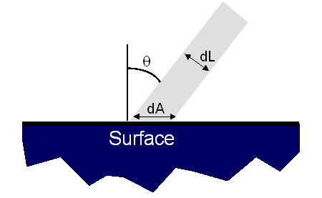
Diffuse Reflection
How much light is reflected?
Depends on angle of incident light
dL = dA cos θ = Ν ⋅ L
Maximum at the head-on light (θ = 0)
N
L

Slide 13
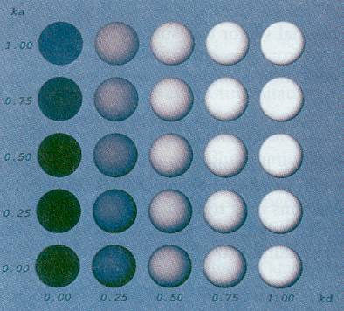
Ambient and Diffuse
Ambient
Diffuse

Slide 14
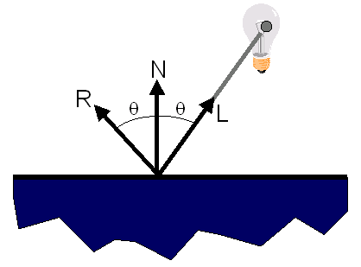
Specular Reflection
Strongest reflection near the mirror angle
Examples: mirrors, metals

Slide 15
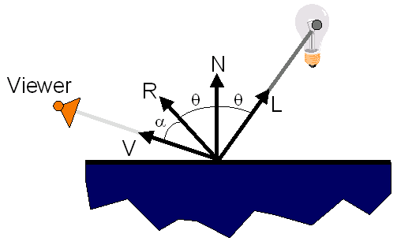
Specular Reflection
How much light is reflected?
Depends on
Angle of incident light
Angle to viewer

Slide 16
Specular Reflection
Phong model
{cos(α)}^{n} = (V⋅R)^{n}
n: exponent
Ks: Specular Reflectance Factor

Slide 17
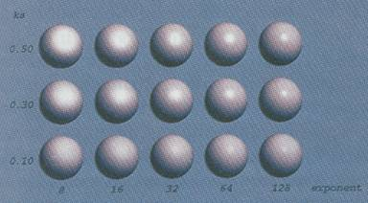
Effects of Exponent
Ambient
Exponent(n)

Slide 18
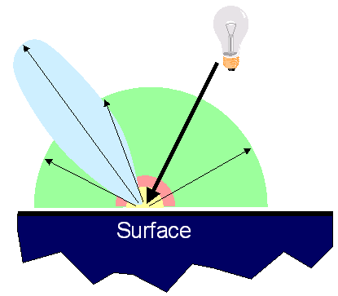
Reflectance Model
Simple analytic model
Emission
Ambient
Diffuse reflection
Specular reflection

Slide 19
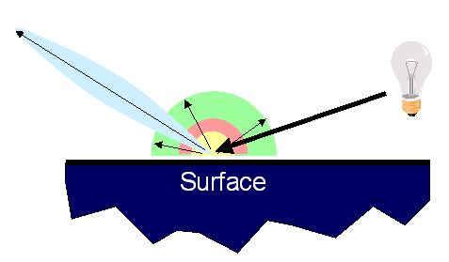
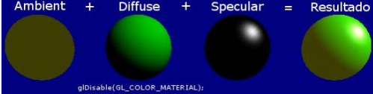
Reflectance Model
Simple analytic model
Emission
Ambient
Diffuse reflection
Specular reflection
Not affected by the position of the light source
Affected by the position of the light source

Slide 20
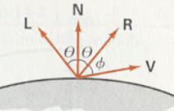
Light Intensity Function
I_{E}: emitted intensity for light sources
K_{A}, K_{D}, K_{s} : ambient / diffuse / specular reflection coefficient
I_{AL} : ambient light intensity
N : unit normal vector
L : unit direction vector to the point light source from a position on the surface
I_{L}: the intensity of the point light source
V: unit viewing direction vector
R: specular reflection vector
n : specular reflection parameter

Slide 21
Surface Illumination Calculation
Single light source

Slide 22
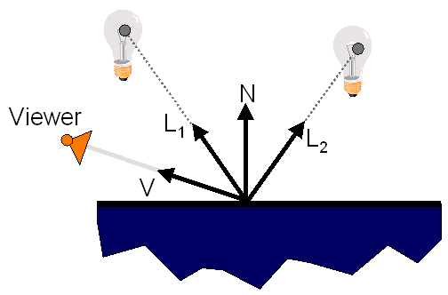
Surface Illumination Calculation
Multiple light sources
Not Affected

Slide 23
Transparency
Alpha value
How much light can be transmitted?
Back to front

Slide 24
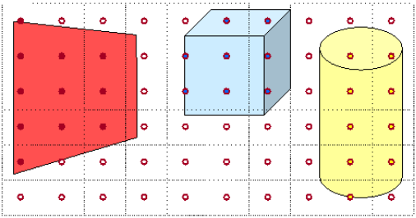
Polygon Shading
Spatial coherence
Illumination calculations for pixels covered by the same primitive

Slide 25
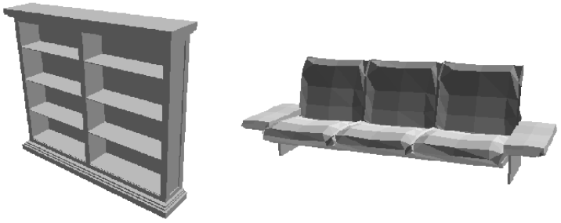
Flat Shading
Constant-intensity shading
OK for polyhedral objects
Not so good for ones with smooth surfaces

Slide 26
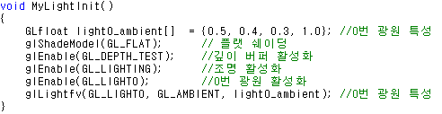
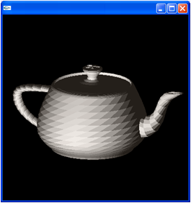
OpenGL Shading
Flat Shading
glShadeModel(GL_FLAT)

Slide 27
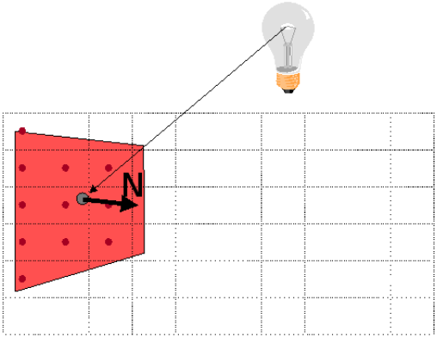
Flat Shading Process
One illumination calculation per polygon
Assign all pixels inside each polygon the same color
Polygon Normal Vector

Slide 28
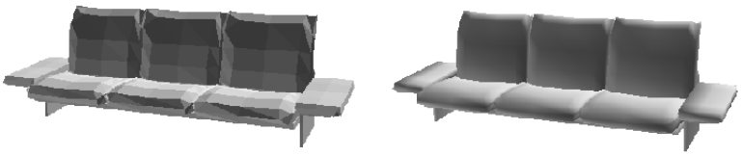
Gouraud Shading
Intensity-interpolation scheme
Produces smoothly shaded polygonal mesh
Piecewise linear approximation
Can’t capture subtle lighting effects
Needs fine mesh → Phong shading solves it
<Flat Shading>
<Gouraud Shading>

Slide 29
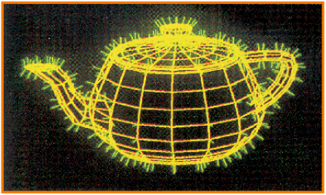
Gouraud Shading
Polygonal mesh with the vertex normal vectors
Smooth shading over adjacent polygons
Curved surfaces
Illumination highlights
Soft shadows
Mesh with Shared Normals at Vertices

Slide 30
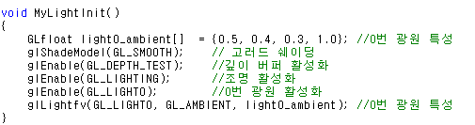
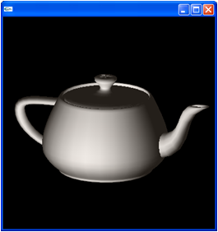
OpenGL Shading
Gouraud Shading
glShadeModel(GL_SMOOTH)

Slide 31
Gouraud Shading Process (1/2)
One lighting calculation per vertex
Assign pixels inside polygon
By interpolating colors computed at vertices
N1
Viewer
V1
L1
Light
N2
N3
Polygon
Vertex Normal Vector

Slide 32
Vertex Normal Vector
Average of the surface normals
For each polygon sharing that vertex
N2
N1
N3
N4

Slide 33
Gouraud Shading Process (2/2)
Bilinearly interpolate colors at vertices
Down and across scan lines
I1
I
I2
I3

Slide 34
Phong Shading
Normal-vector interpolation shading
Subtle illumination effects in polygon interiors

Slide 35
Phong Shading Process (1/2)
One lighting calculation per pixel
Approximate surface normals for inside points
N1
Viewer
V1
L1
Light
N2
N3
Polygon

Slide 36
Phong Shading Process (2/2)
Bilinearly interpolate surface normals at vertices
Down and across scan lines
N1
N
N2
N3

Slide 37
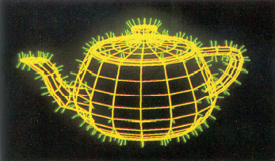
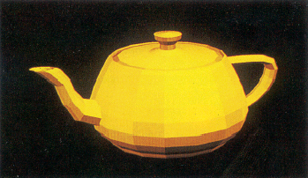
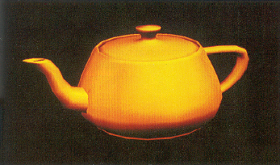
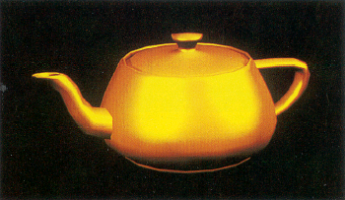
Various Shading Results
<Wireframe>
<Flat>
<Gouraud>
<Phong>

Slide 38
Summary
Polygon shading
Flat shading
Gouraud shading
Phong shading
Supported by OpenGL

Slide 39
OpenGL Lighting
Must enable “lighting calculation” and each “light source”
All colors will be assigned based on light sources and material properties not by glColor*( )
glEnable(GL_LIGHTING);
glEnable(GL_LIGHT0);

Slide 40
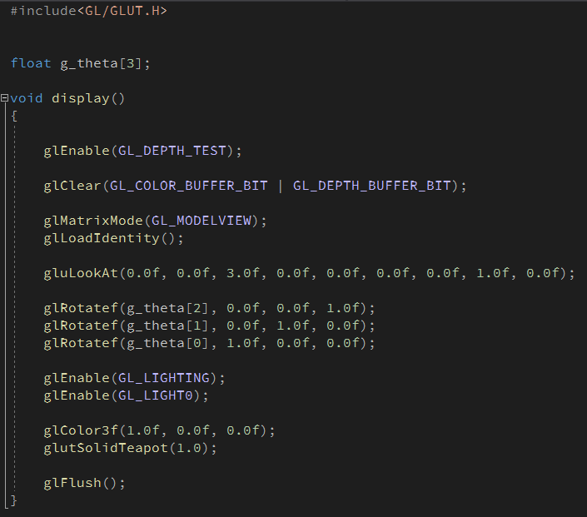
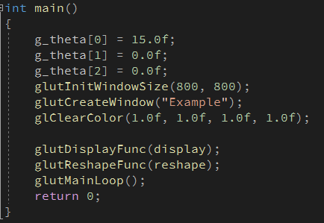
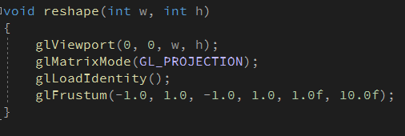
Enable Lighting (1/2)

Slide 41
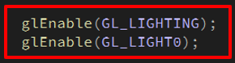
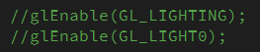
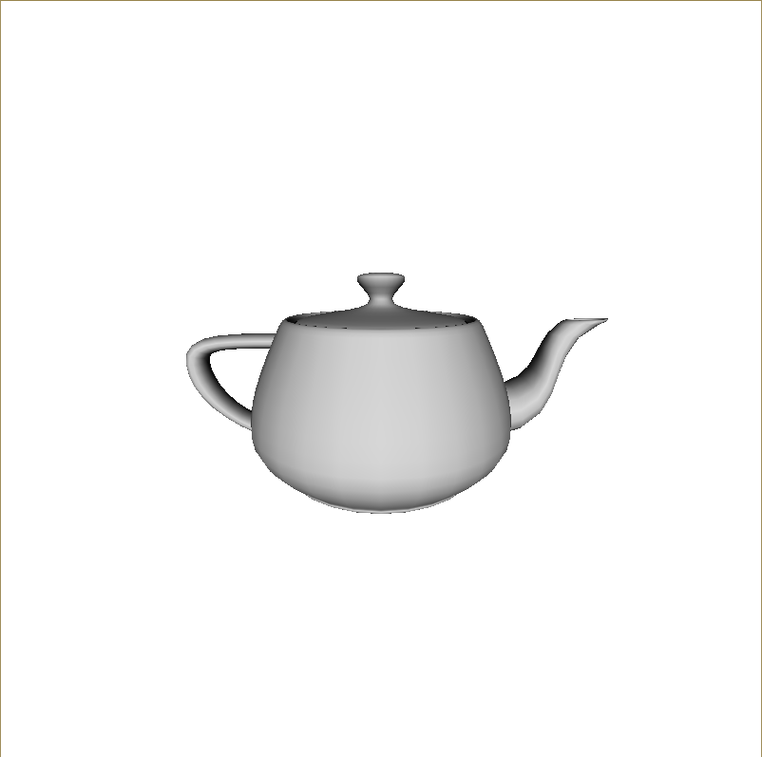

Enable Lighting (2/2)

Slide 42
Specifying a Light Source (1/2)
Defaults for “glEnable(GL_LIGHT0)”
No ambient light
Diffuse and specular component
– white (1.0, 1.0, 1.0, 1.0)
Cf) Other lights – black (0.0, 0.0, 0.0, 1.0)
Position
– (0.0, 0.0, 1.0, 0.0) ➔ directional light

Slide 43
Specifying a Light Source (2/2)
Create a light source
light
GL_LIGHT0, GL_LIGHT1, …
param
GL_POSITION, GL_DIFFUSE, GL_SPECLAR, GL_AMBIENT
glLightfv(GLenum light, GLenum param, TYPE *value);

Slide 44
Light Sources
Distant light
GL_POSITION, GL_DIFFUSE, GL_SPECULAR, GL_AMBIENT
Point light
GL_CONSTANT_ATTENUATION, GL_LINEAR_ATTENUATION, GL_QUADRATIC_ATTENUATION
Spot light
GL_SPOT_DIRECTION, GL_SPOT_CUTOFF, GL_SPOT_EXPONENT

Slide 45
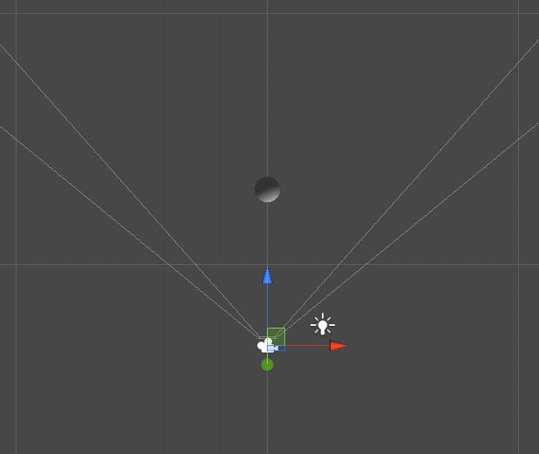
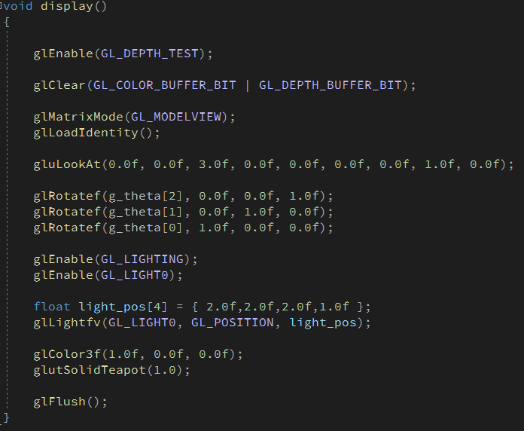
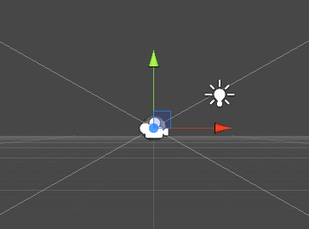
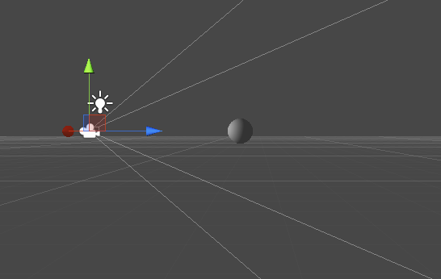
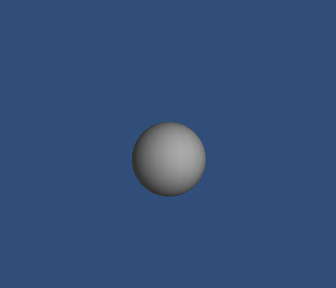
Point Light Source (1/2)

Slide 46
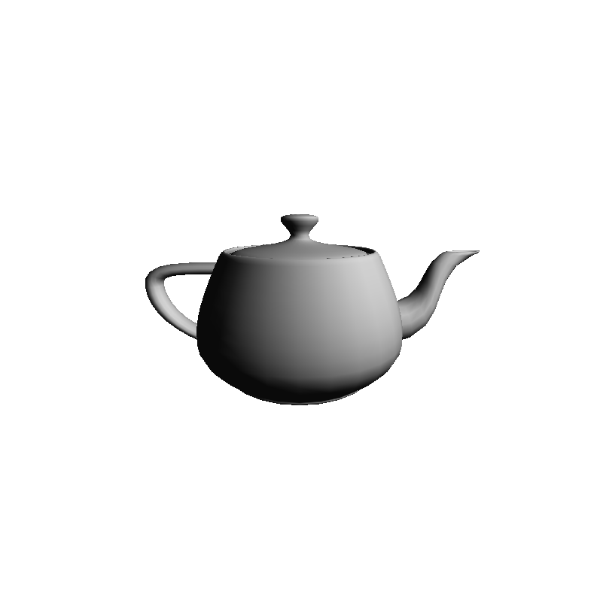
Point Light Source (2/2)

Slide 47
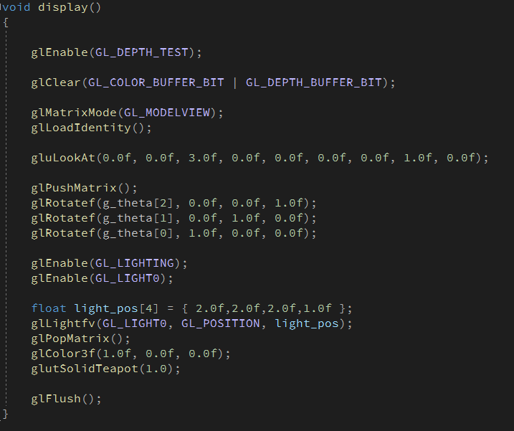
Control of Light Position (1/4)

Slide 48
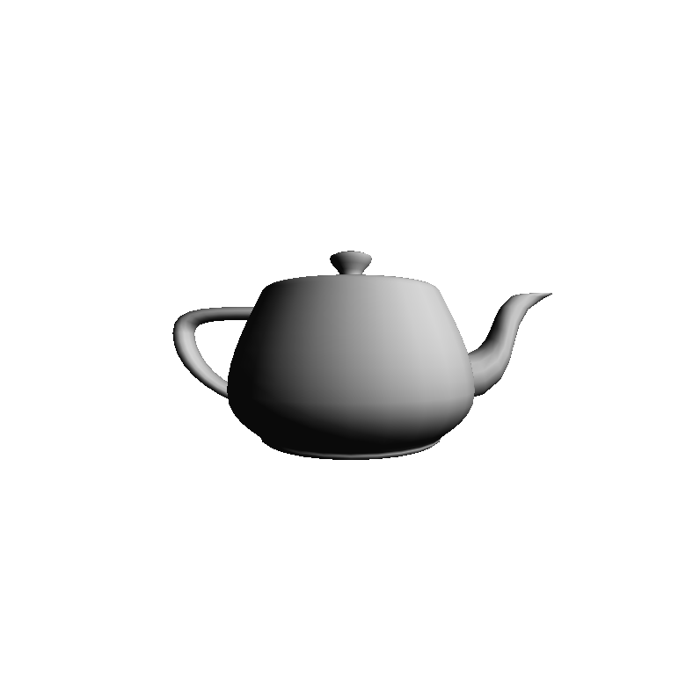
Control of Light Position (2/4)

Slide 49
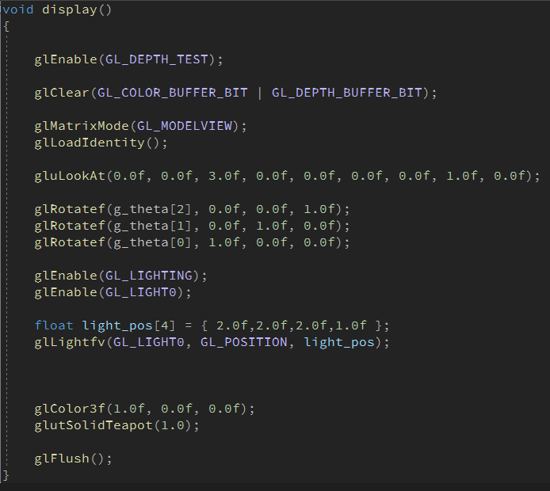
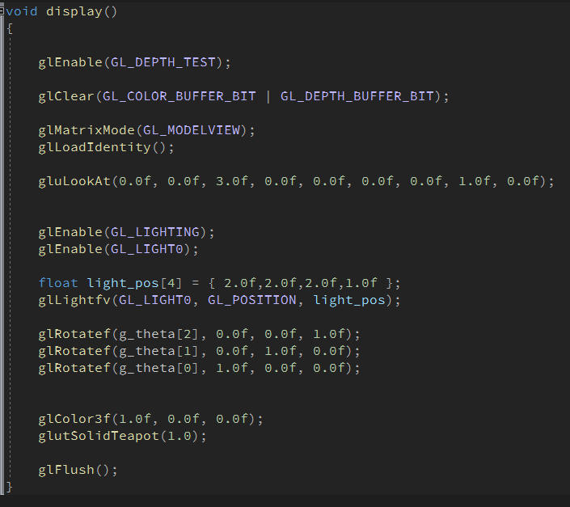


Control of Light Position (3/4)
조명과 물체가 함께 회전
조명은 불변, 물체만 회전

Slide 50


Control of Light Position (4/4)

Slide 51




Control of Light Position (4/4)

Slide 52

Specifying All Terms (1/2)

Slide 53

Specifying All Terms (2/2)

Slide 54

Point Light – Attenuation (1/2)

Slide 55




Point Light – Attenuation (2/2)

Slide 56


Spot Light (1/4)

Slide 57



Spot Light (2/4)

Slide 58

Spot Light (3/4)

Slide 59

Spot Light (4/4)

Slide 60

Multiple Lights (1/2)

Slide 61

Multiple Lights (2/2)

Slide 62
Specifying a Material (1/5)
Reflectivity properties of a material
face
GL_FRONT, GL_BACK, GL_FRONT_AND_BACK
name
GL_DIFFUSE, GL_SPECLAR, GL_AMBIENT, GL_AMBIENT_AND_DIFFUSE, GL_EMISSION, GL_SHININESS
glMaterialfv(GLenum face, GLenum name, TYPE value);

Slide 63

Specifying a Material (2/5)

Slide 64

Specifying a Material (3/5)

Slide 65


Specifying a Material (4/5)

Slide 66

Specifying a Material (5/5)

Slide 67

White Shiny Material (1/2)

Slide 68

White Shiny Material (2/2)

Slide 69

Brass Material (1/2)

Slide 70

Brass Material (2/2)

Slide 71

Red Plastic Material (1/2)

Slide 72

Red Plastic Material (2/2)

Slide 73

Multiple Objects (1/2)

Slide 74

Multiple Objects (2/2)

Slide 75

Wireframe

Slide 76

Ambient Illumination Only

Slide 77

Flat Shaded Polygons with Diffuse Reflection

Slide 78

Gouraud Shaded Polygons with Diffuse Reflection

Slide 79

Gouraud Shaded Polygons with Specular Reflection

Slide 80

Phong Shaded Polygons with Specular Reflection

